Slide 1
Urbanization, food systems, and the diet transformation in developing countries: What do we know, and what do we need to know?
David Tschirley
Keynote Address for “Hungry Cities: The Global Revolution in Food Systems”
Sponsored by the ILSI Research Foundation
La Jolla, CA, 23 January, 2017

Slide 2
Background
Extensive analysis of household expenditure data sets across Africa and Asia
Processed foods inventories
“Stacked surveys” of rapidly growing value chains
30 years of fieldwork in Africa and Asia
A focus on linking rural and urban, not just on urban needs

Slide 3
What do we know?

Slide 4
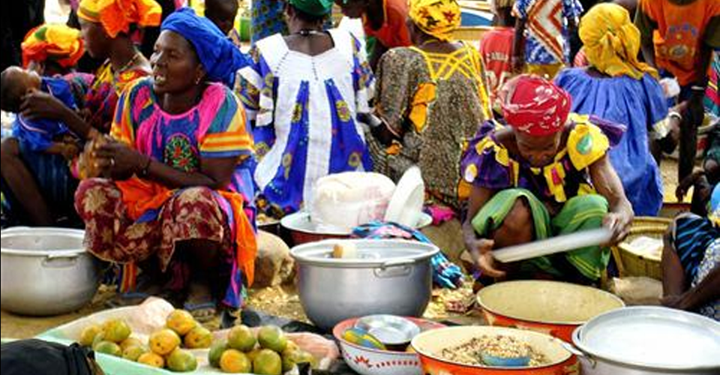
#1: Diets are transforming in three ways
Food is becoming more purchased
About 50% of food in rural areas of Africa (by value) is purchased
60% to 70% in Asia

Slide 5
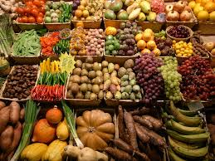
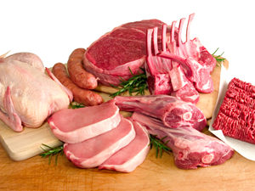
#1: Diets are transforming in three ways
Food is becoming more perishable
meats, dairy, fresh produce (especially fruit and new vegetables)
Non-cereals are 50% to 70% of diets in value terms

Slide 6
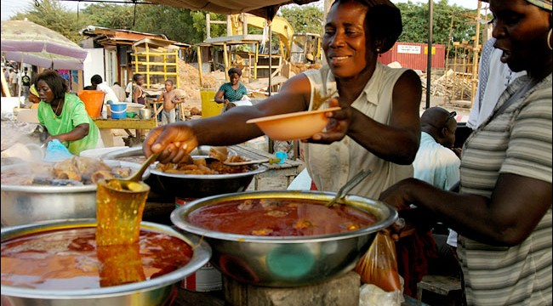
#1: Diets are transforming in three ways
Food is becoming more processed and prepared
50% to 65% of all food is now processed
70% to 80% of purchased food
Food away from home exceeds 15% of food expenditure in some countries of ESA
and is growing everywhere more rapidly than any other category

Slide 7
Every one of these transformations means the post-farm segment of the agrifood system is becoming ever more important

Slide 8
#2: The transformation is not JUST AN urban middle class STORY
The transformation is broad
In rural and urban areas
Across Africa and Asia
Across the income distribution (not just the middle- and upper classes)

Slide 9
Categorization scheme used in LSMS data
 | Unprocessed | Processed, Low Value Added | Processed, High Value Added
Non-perishable | Legumes Maize grain others | Maize meal Milled Rice Sugar Others | Veg oils Breads Food away from home Others
Perishable | Vegetables Fresh fish Fruit Others | Beef Other meat (incl. poultry) Dried/pkgd fish Others | Food away from home Dairy Others

Slide 10
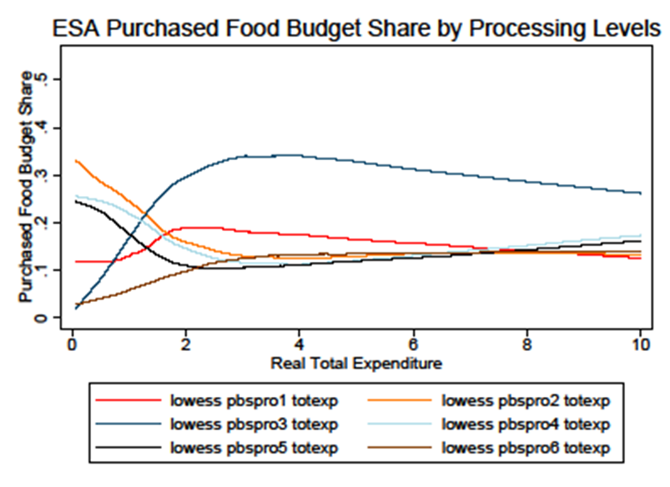
Kernel regression results on purchased food budget shares,
additionally weighted by population across 5 countries of ESA
Unprocessed non-perishable
Low processed non-perishable
High processed non-perishable
Unprocessed perishable
Low processed perishable
High processed perishable
Source: Author calculations from LSMS data sets

Slide 11
Kernel regression results on purchased food budget shares,
additionally weighted by population across 5 countries of ESA
Unprocessed non-perishable
Low processed non-perishable
High processed non-perishable
Unprocessed perishable
Low processed perishable
High processed perishable
Source: Author calculations from LSMS data sets

Slide 12
Kernel regression results on purchased food budget shares,
additionally weighted by population across 5 countries of ESA
Unprocessed non-perishable
Low processed non-perishable
High processed non-perishable
Unprocessed perishable
Low processed perishable
High processed perishable
Source: Author calculations from LSMS data sets

Slide 13
Kernel regression results on purchased food budget shares,
additionally weighted by population across 5 countries of ESA
Unprocessed non-perishable
Low processed non-perishable
High processed non-perishable
Unprocessed perishable
Low processed perishable
High processed perishable
Source: Author calculations from LSMS data sets

Slide 14
Kernel regression results on purchased food budget shares,
additionally weighted by population across 5 countries of ESA
Dramatic diet change has already occurred by the time a household rises up to the international poverty line
Unprocessed non-perishable
Low processed non-perishable
High processed non-perishable
Unprocessed perishable
Low processed perishable
High processed perishable
Source: Author calculations from LSMS data sets

Slide 15
Kernel regression results on purchased food budget shares,
additionally weighted by population across 5 countries of ESA
So there is enormous pressure on the agrifood system, NOW, to respond
Unprocessed non-perishable
Low processed non-perishable
High processed non-perishable
Unprocessed perishable
Low processed perishable
High processed perishable
Source: Author calculations from LSMS data sets

Slide 16
#3: Urban demand is driving the transformation
Urban demand now over 50% of all food demand through markets in East and Southern Africa
The least urbanized area of the continent
Up to 70% and 80% elsewhere
Very rapid growth
3% to 4% growth in urban populations PLUS …
2% to 5% growth in per capita incomes …
means explosive growth in urban demand through markets
Up to 8x over 30 years

Slide 17
#3: Urban demand is driving the transformation
Urban demand now over 50% of all food demand through markets in East and Southern Africa
the least urbanized area of the continent
Up to 70% and 80% elsewhere
Very rapid growth
3% to 4% growth in urban populations PLUS …
2% to 5% growth in per capita incomes …
means explosive growth in urban demand through markets
Up to 8x over 30 years

Slide 18
#3: Urban demand is driving the transformation
Especially secondary and tertiary cities
About 60% of urban population, growing rapidly
A chance to “get it right” in urban areas with little marketing infrastructure

Slide 19
#4: Local demand and supply dominate
About 90% of all food is from local production
And reliance on imports is not systematically rising, even in Africa

Slide 20
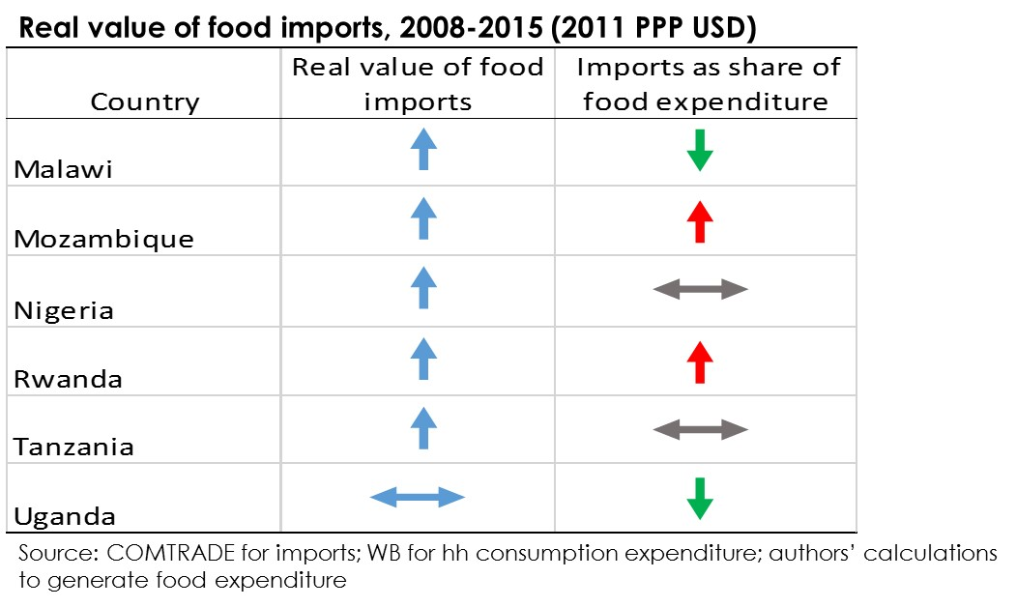
#4: Local demand and supply dominate

Slide 21
#4: Local demand and supply dominate

Slide 22
#4: Local demand and supply dominate

Slide 23
#4: Local demand and supply dominate
In urban East and Southern Africa, the import share in the diet does not rise with income
Import shares do rise with income in rural areas …
And they are higher in urban- than in rural areas
But both appear to be driven by the move to purchased food, not by income per se

Slide 24
Contrary to conventional wisdom, many countries in Africa are “holding their own” in meeting their food needs, and rising incomes per se should not change this

Slide 25
#5: Flow of food bi- and even tri-directional
Rural-urban
What we’ve always known
But now more than ever, linking to urban demand is central to rural growth and poverty alleviation
Urban-rural
Flow of processed foods out to small towns and rural areas
Might this change with more distributed energy generation (solar)?
Rural-rural
e.g. oilseed processing concentrated in areas around production, then flows to other rural areas

Slide 26
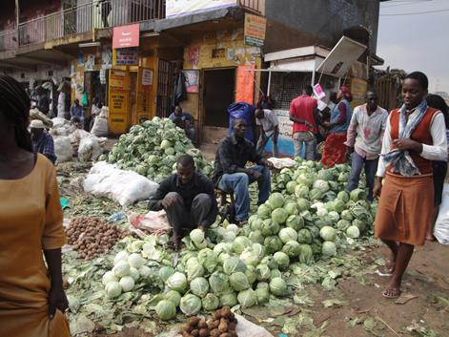
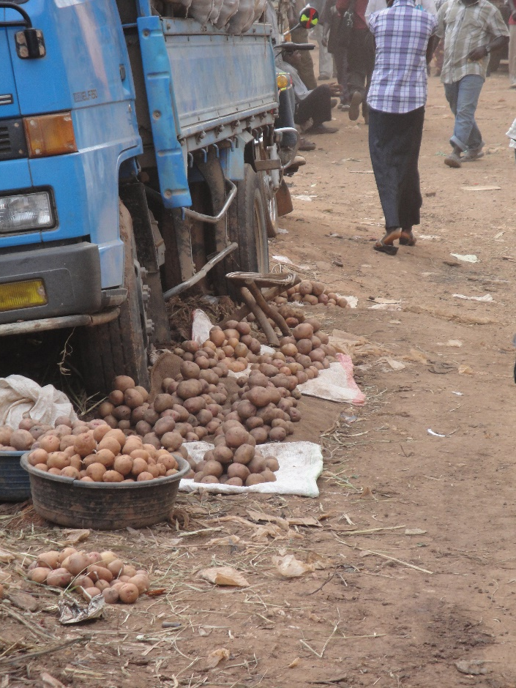
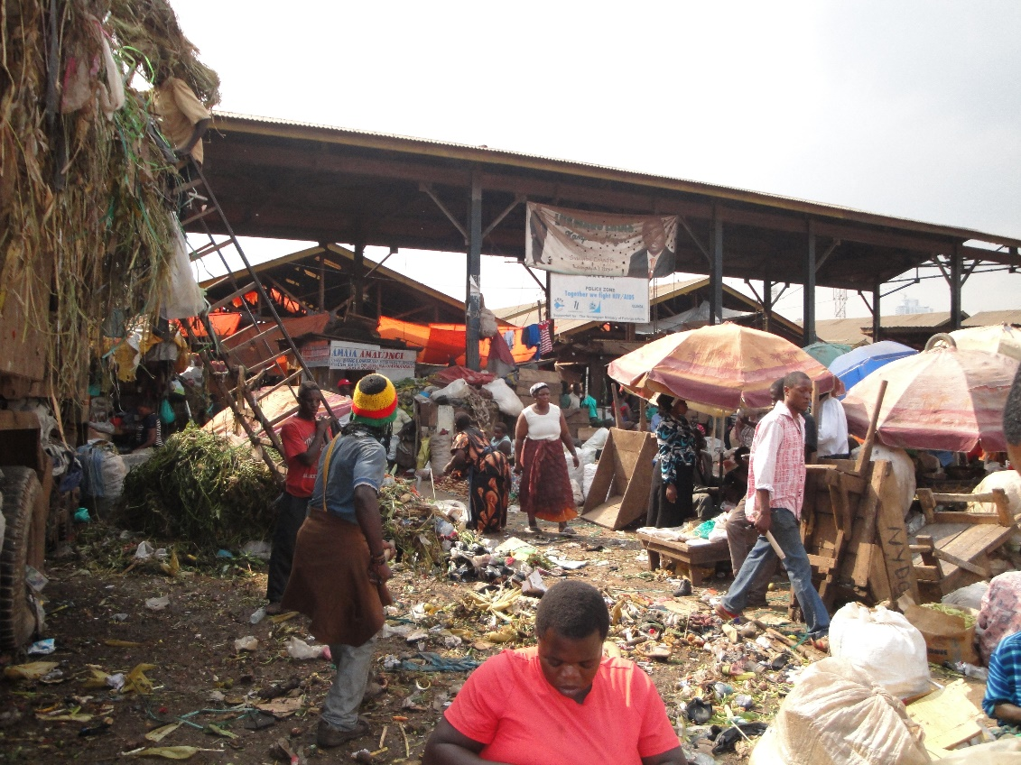
#6: Cities are not adequately prepared

Slide 27
#6: Cities are not adequately prepared
10 Asian cities and 11 of SSA have signed the Milan Urban Food Pact
But very little investment (certainly in SSA)
Unsuccessful attempts (Nairobi)
Appalling conditions (at least in Africa)
Outmoded models for investment and management in urban marketing infrastructure
Food not being integrated into urban planning
Africa and Asia

Slide 28
#6: Cities are not adequately prepared
In Africa, the supermarket revolution is obvious, but very young
Supermarket sales need to rise by more than 5% per year just to MAINTAIN their SMALL market share!
Private investment cannot be expected to solve the dramatic inadequacy of urban marketing infrastructure in the short- to medium-term

Slide 29
Three broad implications

Slide 30
Implications
Massive agribusiness opportunities
Who’s going to capture the growth?
Imports, or local farmers and processors?
If local: large, medium, or small?
Massive challenge for cities
Need for new physical infrastructure
New ownership and management models
Increasing importance of food quality and safety

Slide 31
What we need to know
(an incomplete list!)

Slide 32
#1: Who is responding to the opportunities?
What is the level, structure, and spatial distribution of the local agribusiness response?
Major implications for level and location of employment
Among Tanzanian millers:
smallest 20% of grain millers employ 15x more labor per unit output
Next smallest employ 6x as many

Slide 33
#1: Who is responding to the opportunities?
What’s the role of smallholder farmers in the emerging supply chains?
Are more effective linkages emerging, or will they be by-passed?
… as they largely are by the rapidly growing but still small supermarket sector

Slide 34
#2: How rapidly are supermarkets taking over market share?
Currently low in Africa and S Asia, higher in E and SE Asia
The sector can grow very rapidly in total sales while growing very slowly in market share
Continuing role, for a long time, for the so-called traditional marketing system

Slide 35
#3: ARE SMEs bad for safety and quality?
How does nutritional quality and food safety vary by:
Imported vs. local products ?
Firm size among locals?
Some concerned that SMEs are a major problem for food safety
Sets up a potential major conundrum:
how to promote greater employment growth in agrifood system while safeguarding food quality and safety?

Slide 36
#4: What are the obesogenic foods and how are they reaching consumers?

Slide 37
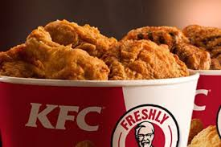
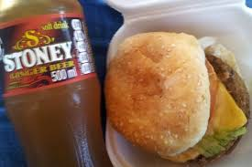

Slide 38
We may be accustomed to thinking about the
degradation of developing country diets as a product only of FDI, and packaged foods

Slide 39
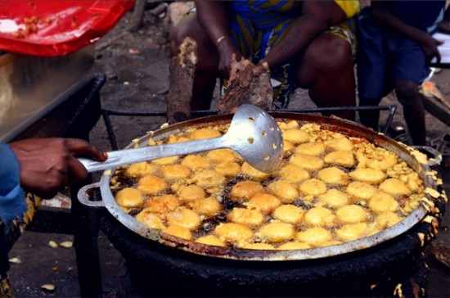

Slide 40
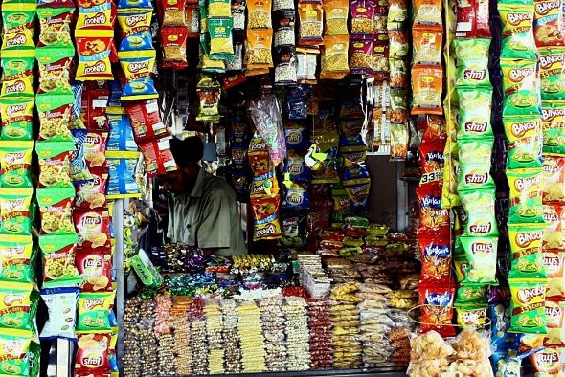

Slide 41
Traditional prepared foods, and traditional market outlets, can be major elements of this problem

Slide 42
#5: How can we foster competitive response by local smes?
The role of credible public grades and standards for quality and safety
Piggybacking by the small guys
Lots of agencies to promote small industry but have been marginally effective
Scalable renewable energy?
Cooperative wholesaling models?
It’s probably about slowing consolidation, not stopping it

Slide 43
#6: How can we help (African?) cities break out of their dysfunctional approach to urban food marketing?
New models of ownership and management
Integrating food into urban planning
Modifying the food environment to promote healthy food choices
Must deal with the political economy problem

Slide 44
Questions?

